Slide 1
Jenkins – CI Server
29-Aug-2018

Slide 2

Noticeable Challenges and Trends
AGENDA
01
What is Jenkins
02
Why Jenkins
03
Jenkins Architecture
04
Jenkins Plugins configuration
04
05
Jenkins Plugins configuration
08
Creation of Jobs , Pipelines
06
07
Q & A

Slide 3
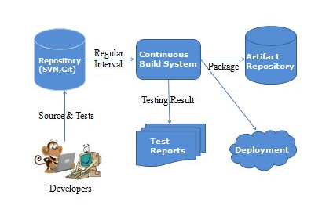
What is it?
Continuous Integration (CI) is a development practice that requires developers to integrate code into a shared repository several times a day. It is a process of running your tests on a non-developer (say testers) machine automatically when someone pushes new code into the source repository. The below diagram shows the CI workflow.
Jenkins is a self-contained, open source automation server which can be used to automate all sorts of tasks related to building, testing, and delivering or deploying software.
Jenkins can be installed through native system packages, Docker, or even run standalone by any machine with a Java Runtime Environment (JRE) installed.

Slide 4
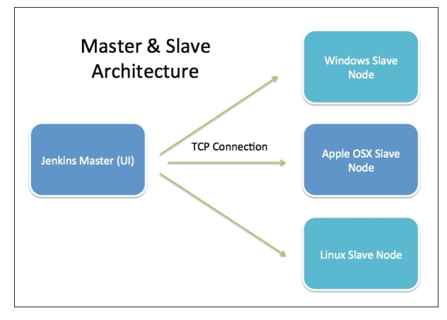
Jenkins Architecture

Slide 5
Jenkins Architecture
Jenkins server is a web dashboard which is nothing but powered from a war file, default run on 8080 ports. Using Dashboard, You can configure the Jobs/Projects but the build takes place in Nodes/Slave.
By default one Nodes/Slave is configured and running in Jenkins Server.
You can add more Nodes/Slave as well using IP address, user name, Password using the ssh/jnlp/webstart methods.
The master’s job is to handle scheduling build jobs, dispatching builds to the slaves for the actual execution, monitor the slaves (possibly taking them online and offline as required) and recording and presenting the build results. Even in a distributed architecture, a master instance of Jenkins can also execute build jobs directly.
The job of the slaves is to do as they are configured in the Jenkins Server, which involves executing build jobs dispatched by the master. You can configure a project to always run on a particular slave machine, or a particular type of slave machine, or simply let Jenkins pick the next available slave.

Slide 6
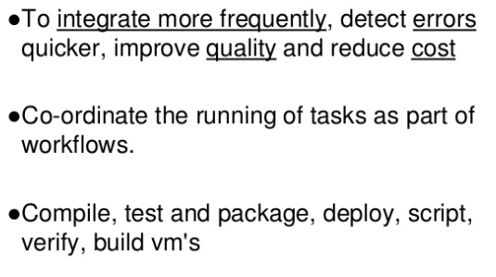
Why Jenkins?

Slide 7
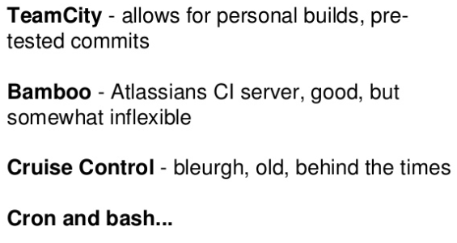
Alternative Tools for Jenkins

Slide 8
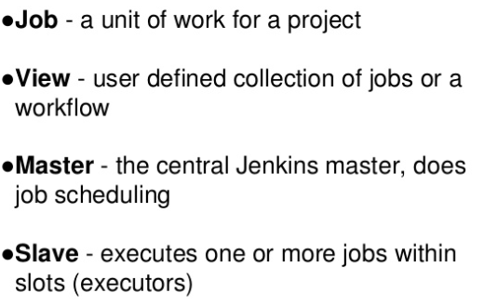
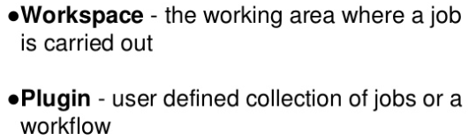
Jenkins Terminology

Slide 9
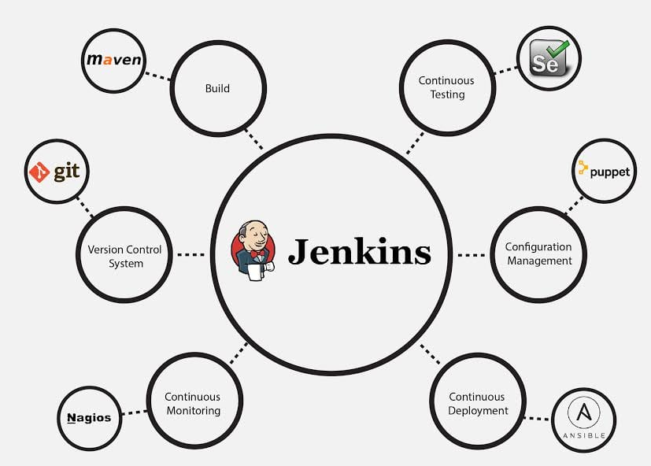
Jenkins Integrations with Various DevOps stages

Slide 10
Jenkins Installation
Pre-requisites:
JDK 1.8 or above
1 GB RAM
Installation:
Download Jenkins installable from below location and follow instructions
https://jenkins.io/download/

Slide 11
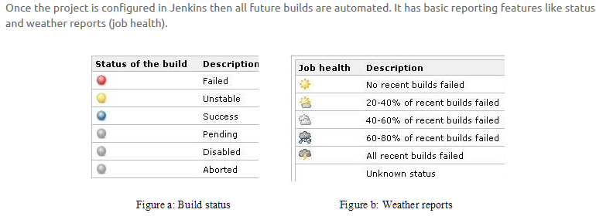

Slide 12
Jenkins Demo
Creation of Jobs
Creation of Pipelines
Integrating with various tools SCM , Maven, Sonar etc
User access Management
Email Notifications

Slide 13
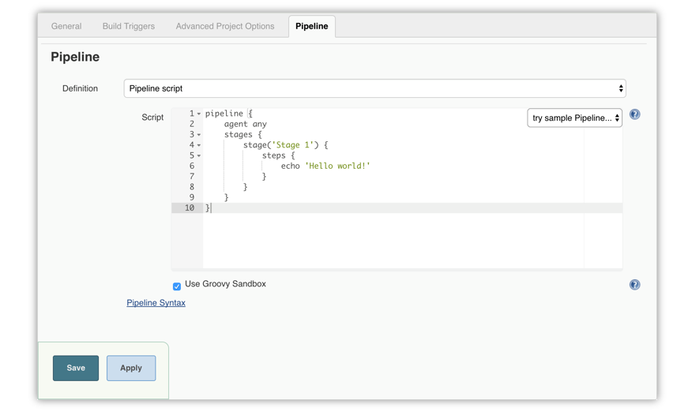
Through the classic UI

Slide 14
SonarQube Architecture
The SonarQube Platform is made of 4 components:
One SonarQube Server starting 3 main processes:
a Web Server for developers, managers to browse quality snapshots and configure the SonarQube instance
a Search Server based on Elasticsearch to back searches from the UI
a Compute Engine Server in charge of processing code analysis reports and saving them in the SonarQube Database
One SonarQube Database to store:
the configuration of the SonarQube instance (security, plugins settings, etc.)
the quality snapshots of projects, views, etc.
Multiple SonarQube Plugins installed on the server, possibly including language, SCM, integration, authentication, and governance plugins
One or more SonarQube Scanners running on your Build / Continuous Integration Servers to analyze projects

Slide 15
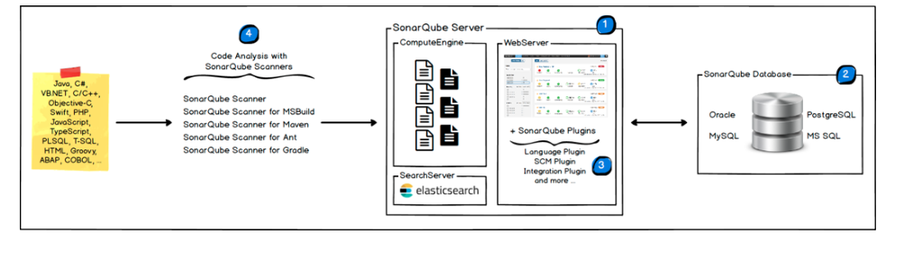
SonarQube Architecture

Slide 16
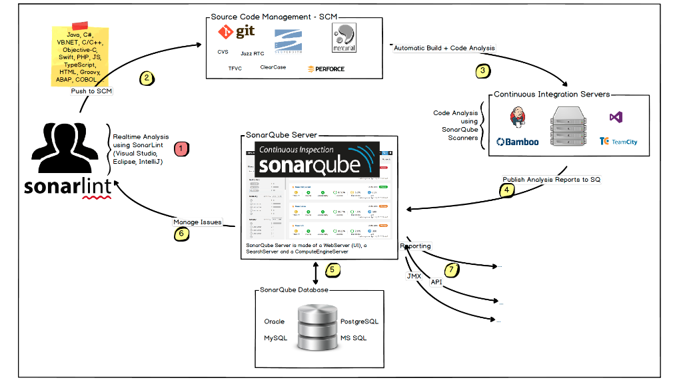
SonarQube Integration

Slide 17
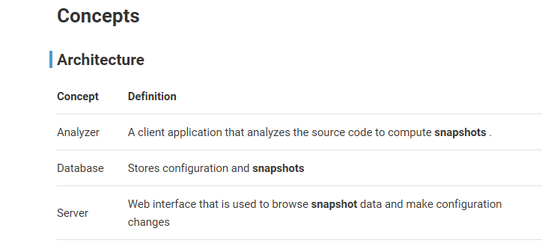
Important Terminologies

Slide 18
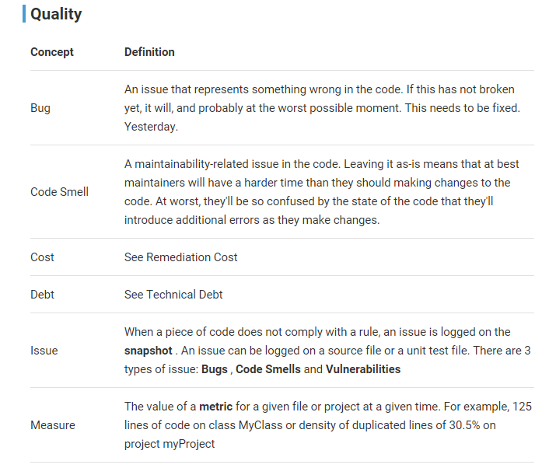
Important Terminologies

Slide 19
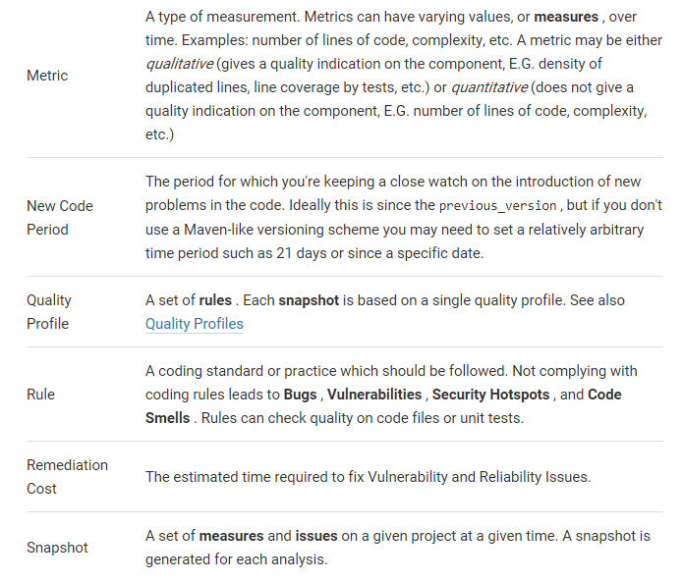
Important Terminologies

Slide 20
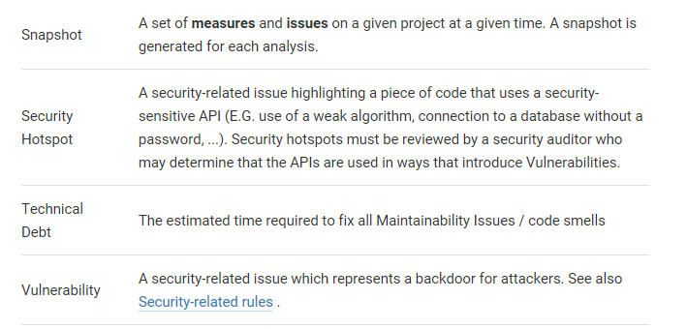
Important Terminologies

Slide 21
Artifactory
Artifactory is a product by JFrog that serves as a binary repository manager.
The binary repository is a natural extension to the source code repository, in that it will store the outcome of your build process, often denoted as artifacts.
Most of the times one would not use the binary repository directly but through a package manager that comes with the chosen technology.
Here are some of the most popular package managers that can be managed using a binary repository:
Java: jar, ear, war etc. has Maven and the official MavenCentral. There are many other package managers that will use the maven binary repository format as well (ivy, Gradle etc.).
.NET: nuget for .NET components (DLL and EXE) but can also be used as a distribution mechanism under windows through systems like Chocolatey. Newer versions of PowerShell can also leverage this to distribute PowerShell modules though the PowerShell gallery of which one could build a local distribution with a binary repository and a repository in nuget format. Also check OneGet if Windows distribution management is of interest to you.
JavaScript: we have npm which is one of the most popular, will require nodejs.
Python: there is pip and the official package index pypi, which one can also create a local instance through binary repository that will support the format.

Slide 22
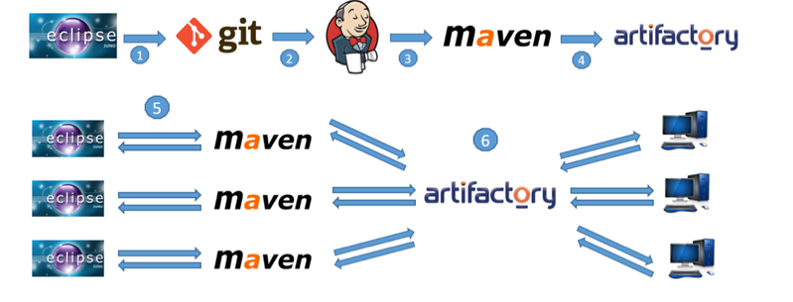
Intergration of Git Maven Jenkins Artifactory
The following scheme shows how the combination of Maven, Jenkins, and Artifactory works in a split team environment to maintain a shared test automation framework.

Slide 23
Intergration of Git Maven Jenkins Artifactory
A common workflow working with Artifactory is as follows:
1. Changes in target project are pushed to Git repository.
2. Jenkins gets latest code from Git and triggers a job.
3. Jenkins job uses Maven goals to package a Jar (clean install) and to assign a proper version to the Jar (-Dbuild.number=${BUILD_NUMBER}).
4. Jar file gets pushed to Artifactory by Jenkins job (as post-build action). Now the artifact is ready to be downloaded and used as a Maven dependency.
5. Maven dependency (POM file) in projects that use target project are updated to the latest version available from Artifactory.
6. Maven downloads dependency from Artifactory and stores it on a local machine (../.m/repositories).

Slide 49


Slide 50
$7 BILLION | 110,000 EMPLOYEES | 31 COUNTRIES

